Slide 1
Mini Update #2
By Brittany Huynh and Carlyn Mangana
04/13/2025

Slide 2
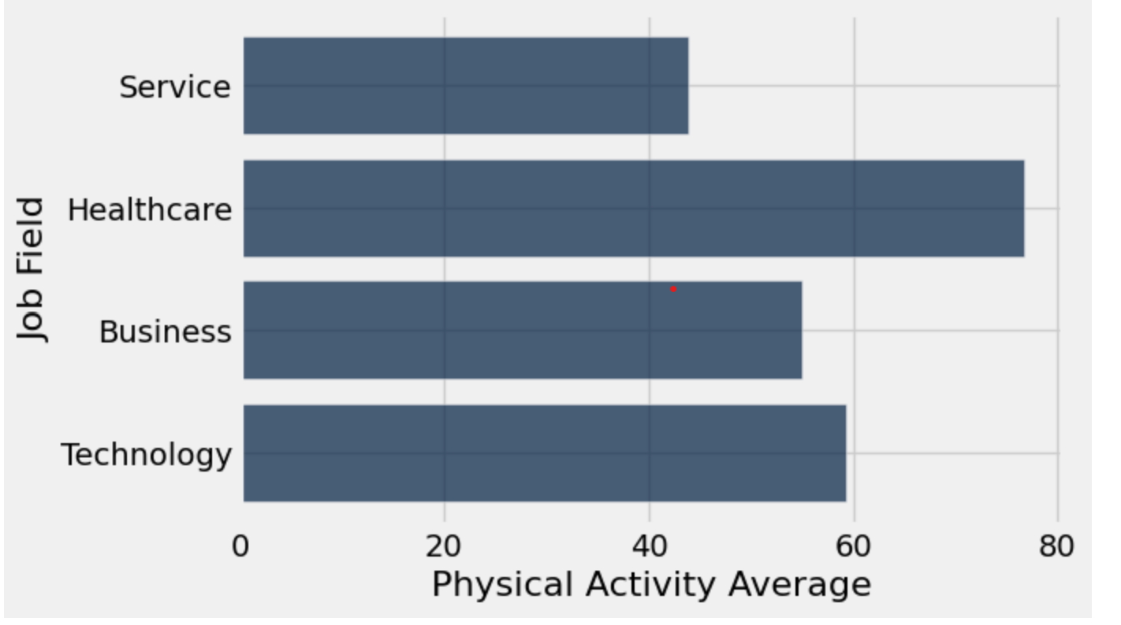
Data Insights
By Carlyn Mangana
This graph shows the various job fields within the data table and how the average physical activity of each job field. The physical activity is on a scale of 0-100, 0 being no physical activity and 100 being very active. Based off of the data results, it seems that healthcare workers have the highest physical activity average. This could be due to the fact that doctors and nurses are always on their feet running around hospitals to tend to those in need. It seems that service workers are the lowest in physical activity average it could indicate that sales representatives these days usually work from home to raise their sales, meaning they don’t need to walk around as much.

Slide 3
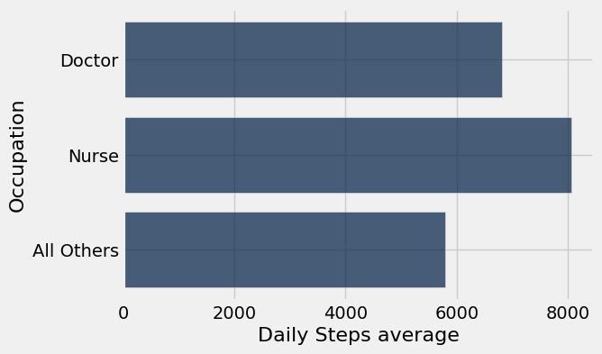
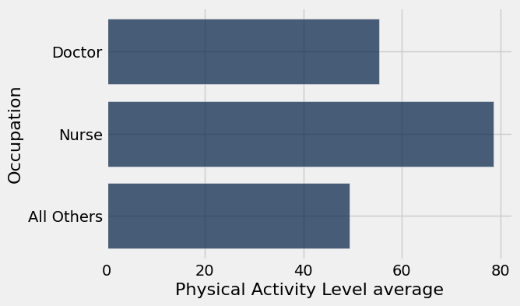
Data Insight: Doctors and Nurses are more physically active than all other occupations on average.
By Brittany Huynh
These bar graphs show the Daily Steps average and Physical Activity Level average of Doctors, Nurses, and all other occupations. These graphs are used to answer my curious question, “Are doctors more physically active than non-doctors?” This insight is similar to Car’s insight on the previous slide. The data shows that both doctors and nurses are more physically active than all other occupations in the dataset, including workers in sales, engineering, education, and more. It’s a well-known fact that moderate amounts of daily physical activity improve well-being, boost heart health, and help maintain a healthy weight. However, this article claims that healthcare workers experienced significant burnout and stress, especially during the height of the COVID-19 pandemic. This leads to me to pose another question, how do the stress levels of doctors and nurses compare to all other occupations in this dataset?

Slide 4
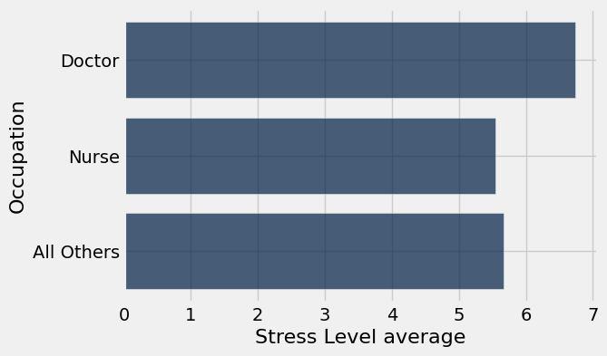
Data Insight: Being a doctor is the most stressful occupation (according to this dataset).
By Brittany Huynh
This graph shows that doctors experienced the highest Stress Level on average compared to nurses and all other occupations. This insight proves the claim from the article in the previous slide that says healthcare workers experience burnout and stress. Doctors’ stress is likely due to physical demands of the job, such as excessive workloads. Doctors are paid extremely well, but does the high salary make up for the stressful nature of the job? Although doctors experience the most stress, nurses’ average stress levels are lower than all other occupations combined.

Slide 5
Progress
By Brittany Huynh
This week, Car and I answered the following curious questions from the previous Mini-Update #1:
How do differing job fields impact physical activity levels?
Are doctors more physically active than non-doctors?
I came up with another curious question:
How do the stress levels of doctors and nurses compare to all other occupations?
As for obstacles, I had trouble figuring out some code, but I contacted Carl on Discord for help. Some other resources I used include the textbook, AI, and previous labs and homeworks.
Carlyn and I both contributed to the project this week. We filled out the spreadsheet and put our names on the slides that we covered in this update.
As for next week, our plan is to:
Answer 2-3 more curious questions
Ask professor or TA’s in class for suggestions on how to come up with more creative ways to analyze the dataset using different types of graphs (we only used bar charts this week, maybe we should try other plots in the future?)
Come up with new questions and insights

Slide 6
Feedback
By Carlyn Mangana
The feedback that we received was that we were missing our data profile so we addressed it by adding a data profile to the mini update #1. The feedback did seem useful as it helped us evaluate our data better and made us realize that we should be cleaning and filtering like values and those that are null. Additional feedback that could benefit us is how to expand upon our questions as well as simplify our methods to extract this information. It would also be helpful if we could get some guidance on how to create more questions to get more information out of our data.

